Slide 1
Blind estimation of acoustic transfer functions (ATFs) and dereverberation based on convolutive transfer functions (CTFs) Date：2022. 10. 04
Telecom Electroacoustics Audio(TEA) Lab
Presenter:
Anchi Yuan
Notes:
Hello everyone
I’m today’s presenter siang. I’m going to share some of my present work in source separation problem. My topic is comparative studies of source separation using semi-blind and blind source separation approaches.

Slide 2
Outline
Simulation setting
Algorithm for moving source case
Processing flow
Simulation result

Slide 3
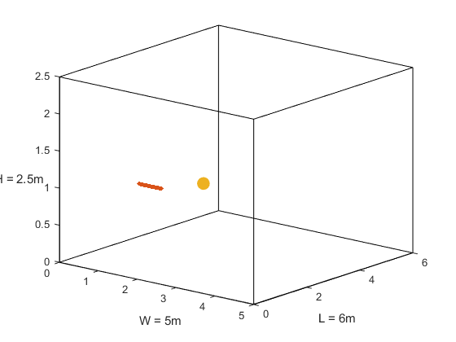

Simulation setting
Uniform linear array (ULA)
Number of microphones = 30
Microphone Spacing = 0.02m (2cm)
Aperture = (30-1)*0.02 = 0.58 m
Room size = 5m $×$6m $×$2.5m
Sampling frequency = 16kHz
Reverberation time T₆₀ = 0.6s
Number of source positions = 4
Moving Source Spacing = 0.1m (10cm)
source
ULA
0.1m
z
y
x

Slide 4
Algorithm for moving source case
Kalman filter nonstationary version

Slide 5
Processing flow
Sampling rate = 16kHz
NFFT = NWIN = 1024
hopsize = 256
Position 1
Position 2
Position 3
Position 4
Second 30 60 90 120 s
End point of section at 1872th 3747th 5622th 7497th frame
Output the CTF coef. at 1871th 3746th 5621th 7496th frame

Slide 6
Simulation result

Slide 7
Simulation result
Fixed source position with 23 seconds
T₆₀ =0.6s | Wiener filter | RLS | Kalman filter stationary | Kalman filter nonstationary
ATF Matching error | 4.7624 | 4.8753 | 4.7647 | 4.8856
Moving source position with each position 30 seconds
T₆₀ =0.6s | Position 1 | Position 2 | Position 3 | Position 4
ATF Matching error | 4.9871 | 4.9273 | 5.5252 | 5.8049

Slide 8


